Slide 1
Monkey Browser
Innovation of digital transformation

Slide 2
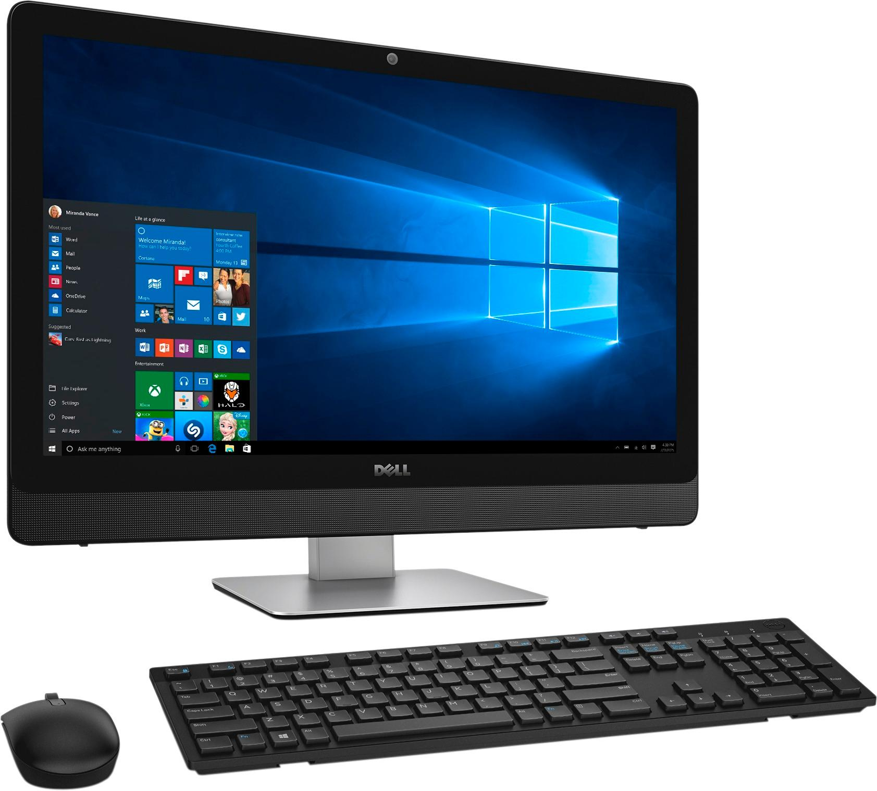
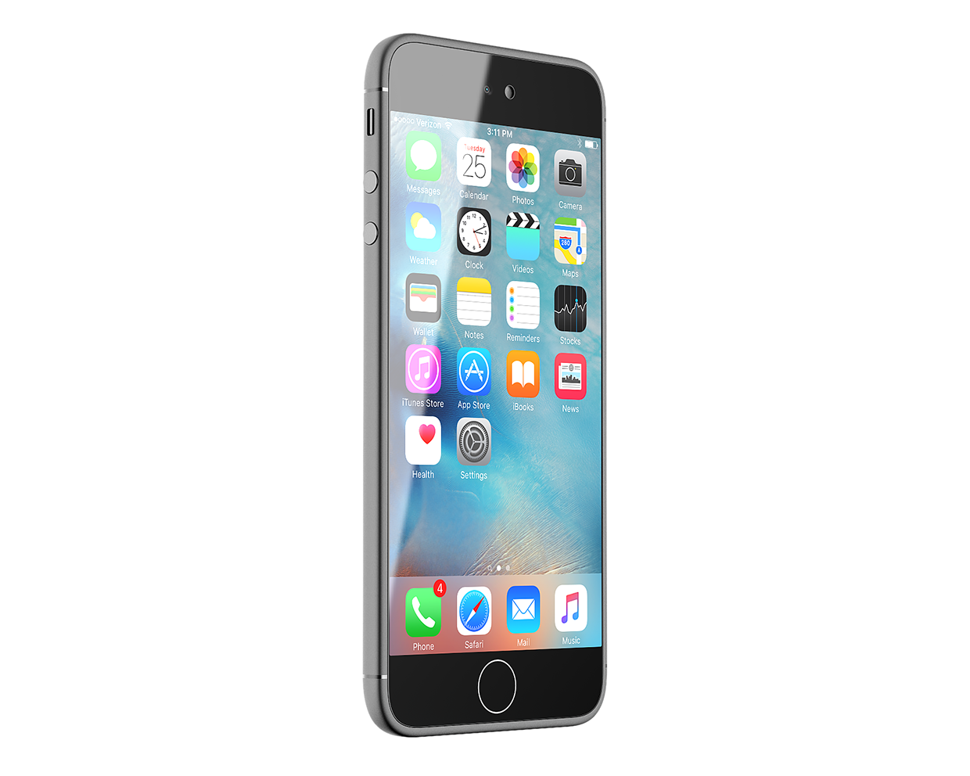
Introduction
3. Auto Get Barcode Scan, NFC Reading, native mobile ability
1. Desktop html web application
2. Running on Monkey Browser on mobile
Monkey browser targets to give native mobile phone device ability to webpage application, for example, barcode scan, NFC (RFID) reading, photo taking, get location to save your investment of Windows computer, barcode scanner NFC reader, and camera to help modern company on digital transformation and mobilization. Your current webpage applications don’t need any change. No need to develop native mobile applications.
至强浏览器的目标是为网页应用程序自动提供条形码扫描，NFC(RFID)读取，照相，获取位置等能力，以节省您对 Windows 计算机、条形码扫描仪，相机和NFC(RFID)读取设备的投资，帮助现代公司进行数字化转型和实现移动化。不仅可用于基本扫描，还可以从具有丰富数据的条形码中提取数据。你现有的网页程序不用做任何改动。无需重新开发原生的移动端程序。

Slide 3
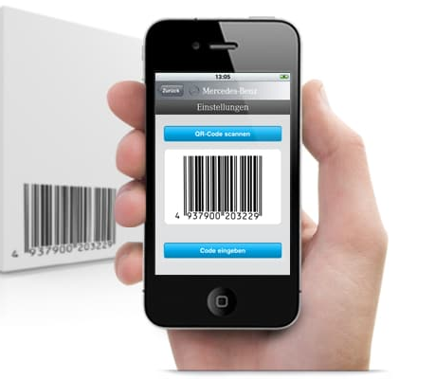

This Monkey Browser help to improve the efficiency of high frequency data collection by Barcode scanning / NFC reading / Photo taking in Plant shopfloor, warehouse, etc. Integrated with ERP system SAP, Manufacture Execution System (MES), Siemens OpCenter / Camstar, Warehouse Management System (WMS), Material Handling System (MHS), etc.
至强浏览器将现有在电脑上运行的网页程序转移到手机上运行，可通过在工厂车间、仓库等进行条形码扫描 / NFC读取 ，手杨拍照上传，帮助提高高频数据收集处理效率和准确性。可与 ERP 系统如SAP、制造执行系统 （MES）如西门子运营中心 / Camstar、仓库管理系统 （WMS）、材料处理系统 （MHS） 等集成在一起，扩展其使用范围及便利性。

Slide 4
Value Creation 价值创造
Saving hardware cost 60% - 90%. You can use mobile phone /tablet to replace your Windows hardware & barcode scanner investment.
节省硬件成本 60% - 90%。您可以使用手机/平板电脑来取代您的Windows硬件和条形码扫描仪的投资。
Saving labor cost about 50% for data input and operator/material movement waste.
节省约 50% 的数据输入和操作员/材料移动浪费的人工成本
Saving power electricity cost about 90%. The mobile is much energy friendly than desktop computer.
节省电力成本约90%。手机比台式电脑更节能。
Saving label and label printing cost about 50% by data abstraction from barcode, you can have only one barcode (normally QR code) on one label with full data to save the label size.
通过从条形码中提取数据，可节省标签本身和标签打印成本约 50%，在一个标签上可以只有一个条形码（通常是 QR 码），包含完整的数据以使用更小的标签。
Saving software development cost about 60% - 80%. By using Monkey browser, you only need to develop or use current applications for web browser with responsive page, no need to develop mobile application meantime.
节省软件开发成本约60% - 80%。通过使用至强浏览器，您只需要开发或者使用现有具有响应页面（自适应屏幕）的浏览器应用程序即可使用手机的扫描功能，无需同时开发移动端应用程序。真正做到一处开发，到处使用。
Improve the employee satisfaction.
提高员工满意度。

Slide 5
Main Function 主要功能
Add the barcode scan & NFC reading functionality to webpage applications.
将条形码扫描和NFC读取功能添加到网页应用程序。
Full content return.
完整的内容返回。
Abstract content by customized grammar.
通过自定义语法抽取需要的内容。
Support almost all kinds of barcode (1D & 2D).
支持几乎所有类型的条形码。
Https support.
HTTPs协议支持
Other web browser basic functions.
其他 Web 浏览器的基本功能。
Support Windows Authentication intranet.
支持Windows身份验证内联网。
Picture taking/picking and pass to webpage DOM.
照相或者从手机中选取图片，以Base64方式返回到网页Html DOM.
Get the device location and pass to webpage DOM.
获取定位，返回到网页Html DOM.

Slide 6
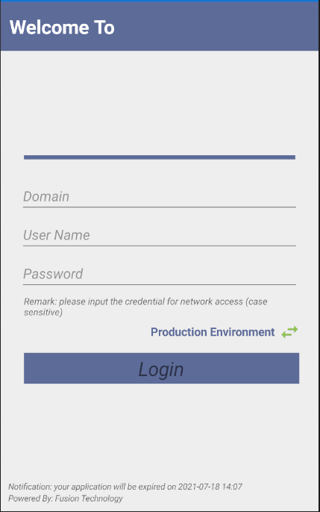
Login Page
Domain: Please input your current domain or company name.
域名：请输入您的域名或公司名称（如果是内部网络，请输入域名）。
Username: your username
用户名：您的用户名
Password: your password.
密码：您的密码。
The above credential you key in is for:
您键入的上述凭据用于：
Windows authentication for your intranet if Monkey is working under windows authentication network.如果程序在Windows身份验证网络下工作，则为您的内联网进行 Windows 身份验证。
User login assistance for further step in webpage.用户 登录辅助，自动录入用户名和密码， 以进一步进入网页。
You can ignore this and login without username and password which may lead webpage access issue if Monkey browser working in and windows authentication network.您可以忽略这一点，登录时无需用户名和密码，如果Monkey浏览器在Windows身份验证网络中工作，这可能会导致网页访问问题。
The application will NOT collect your information and NOT upload to internet, all the data is stored in your mobile phone.应用程序 不会 收集您的信息， 也不会 上传到互联网，所有数据都存储在您的手机中。
You can toggle the environment between Production and Debug. The application setting will different.您可以在生产和调试之间切换环境。应用程序设置将有所不同。

Slide 7
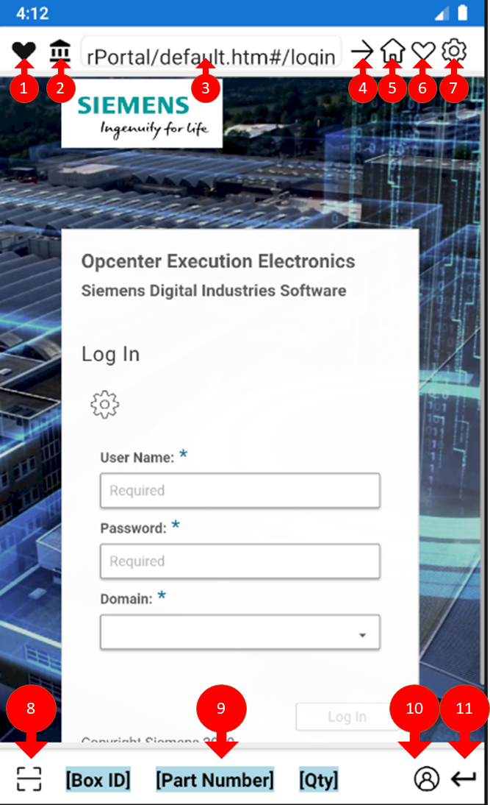
Main Page 主页
Favorite list of your webpage. click this button will list all your favorite pages for selection.您的网页收藏列表。单击此按钮将列出您的收藏页面进行选择。
Home page主页
Input area, you can input the URL by manual or scan barcode by button 8. 输入区域，您可以通过手动输入完整URL，也可以通过按钮8扫描URL条形码。
Forward button, after you key in the URL, click this button will forward to.前进按钮，在 URL 输入后，单击此按钮将前进到。
Update the home page.更新主页。
Add current page to favor list.将当前页面添加到喜爱列表中。
Navigate to setting page.导航到设置页面。
Scan button, after clicking this button, will navigate to scan page, and the full scan content will return to current focus input area of web page of URL entry area.单击此按钮后，扫描按钮将导航到扫描页面， 完整的扫描内容 将返回到 URL 区域或网页的当前焦点输入区域。
Customized scan area will return the parsed scan content by specific grammar defined in setting page.自定义扫描区域将返回解析的扫描内容，具体语法定义在设置页面。
Login assistance button, the current username and password will send to current focus login area.登录辅助 按钮，当前用户名和密码将发送到当前对焦登录区域。
Enter key, will send ENTER KEY to current focus area as mobile phone keyboard has no enter key but some web page java needs it.回车键，将ENTER键发送到当前焦点区域，因为手机键盘没有回车键，但一些网页java需要它。

Slide 8
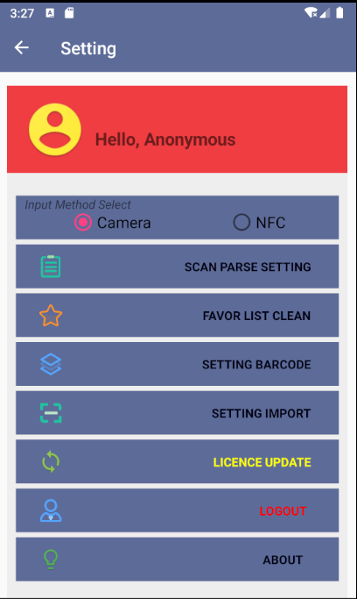
Setting设置
Scan parse setting扫描解析设置
This is to set your customized data abstraction method, the grammar refer to help button “?” inside the setting page.
设置自定义数据抽取方法，语法帮助按钮“？”
Favor list clean – to clean your favorite webpage list.收藏列表清除- 清空收藏网页列表。
Setting barcode – generate one QR code image to share the setting with other users.设置条形码– 生成一个QR代码图像，以便与其他用户共享设置。
Setting import – scan the other users barcode to import the setting.设置导入-扫描其他用户条形码导入设置。
License update – import License.许可证更新–导入许可证。
Logout注销
About – the information about this application.关于-有关此应用程序的信息。

Slide 9

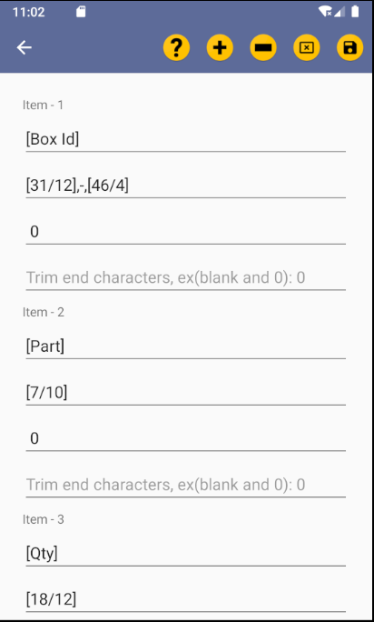
Data Abstraction Setting 数据抽取设置
Data from barcode or NFC tag could be abstracted.
One barcode can have full of the data to save your label, prevent wrong scanning operation.

Slide 10
JavaScript API 开发接口
JS function: monkeyInput(‘domId’, option)
You can invoke this JS function in your webpage, the Monkey Browser will call the native mobile function based on option parameter, and return the result to the webpage DOM passed in.
This function is for advance development, normally, you can use your current webpage application without any further update.
您可以在网页中调用此 js 函数，浏览器将根据选项参数调用手机原生功能，并将结果返回到传递的网页控件。
这个是高阶应用，通常情况下，你现有的网页程序不用做这样的开发，除非你需要主动调用这些功能以做更好的定制。
domId: the web DOM to receive the result get by browser. 通过浏览器接收结果的Dom Id.
Option:
选项参数：
0 – Barcode scan, 1 – NFC reader
Monkey browser will set the value of DOM by result.
0–条形码扫描，1–NFC读卡器
至强浏览器将按结果设置Dom的值。
2 – Take picture, 3 – Pick picture
Monkey browser will set the img tag src attribute to base64 of result picture.
2–拍照，3–选取图片
至强浏览器将设置img标签src属性到结果图片的Base64。
4 – Get location
Monkey browser will set the value of DOM by result(Latitude, Longitude)
4–获取位置
至强浏览器将按结果设置html DOM的值（纬度，经度）

Slide 11
Questions 问题
Ø The barcode scanning does not work.
Ø 条形码扫描不起作用。
The first time you open your camera to scan, app will ask for access, after get right, it will show one white screen, please reboot Monkey Browser. This only happen first time.
第一次打开相机扫描时，会要求权限，获得授权后，会显示一个白色屏幕，请 重新启动 浏览器。重启后扫描功能将正常。
Ø Ask for location?
Ø 询问定位？
The location is for company type License verification, only distance less than License defined distance can be allowed. Application will not collect and upload your location.
位置为公司类型许可证验证使用，仅允许距离小于许可证定义距离。程序不会收集上传你的位置信息。
Ø Cannot access the webpage?
Ø 无法访问网页？
Please check your firewall setting to make sure your Monkey browser is working at the same internet as your webpage application, you can check by other browser to find the problem.
请检查您的防火墙设置，以确保您的浏览器与您的网页应用程序在同一互联网上工作，您可以通过其他浏览器检查以查找问题。
For windows authentication intranet, please make sure you have input the correct domain and user credential when you login.
对于Windows身份验证内联网，请确保登录时输入了正确的域名和用户凭据。
Ø Cannot download files?
Ø 无法下载文件？
This browser target to improve the high frequency operation on shopfloor, not support file download to mobile for this version.
此浏览器旨在改善车间的高频操作，此版本不支持文件下载到手机。

Slide 12
Application Download 下载
Monkey Browser - Google Play 上的应用

